Slide 1

NumPy

Slide 2

NumPy – huh, yeah – what’s it good for?
Introduces new data structure: the array
An array is a regular, N-dimensional grid of data of the same type, typically numerical data

Slide 3
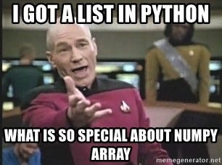
NumPy – huh, yeah – what’s it good for?
Introduces new data structure: the array
An array could be represented as a list-of-lists
Why are NumPy arrays better than a list-of-lists?
**Computer architecture class**
An array is a regular, N-dimensional grid of data of the same type, typically numerical data

Slide 4
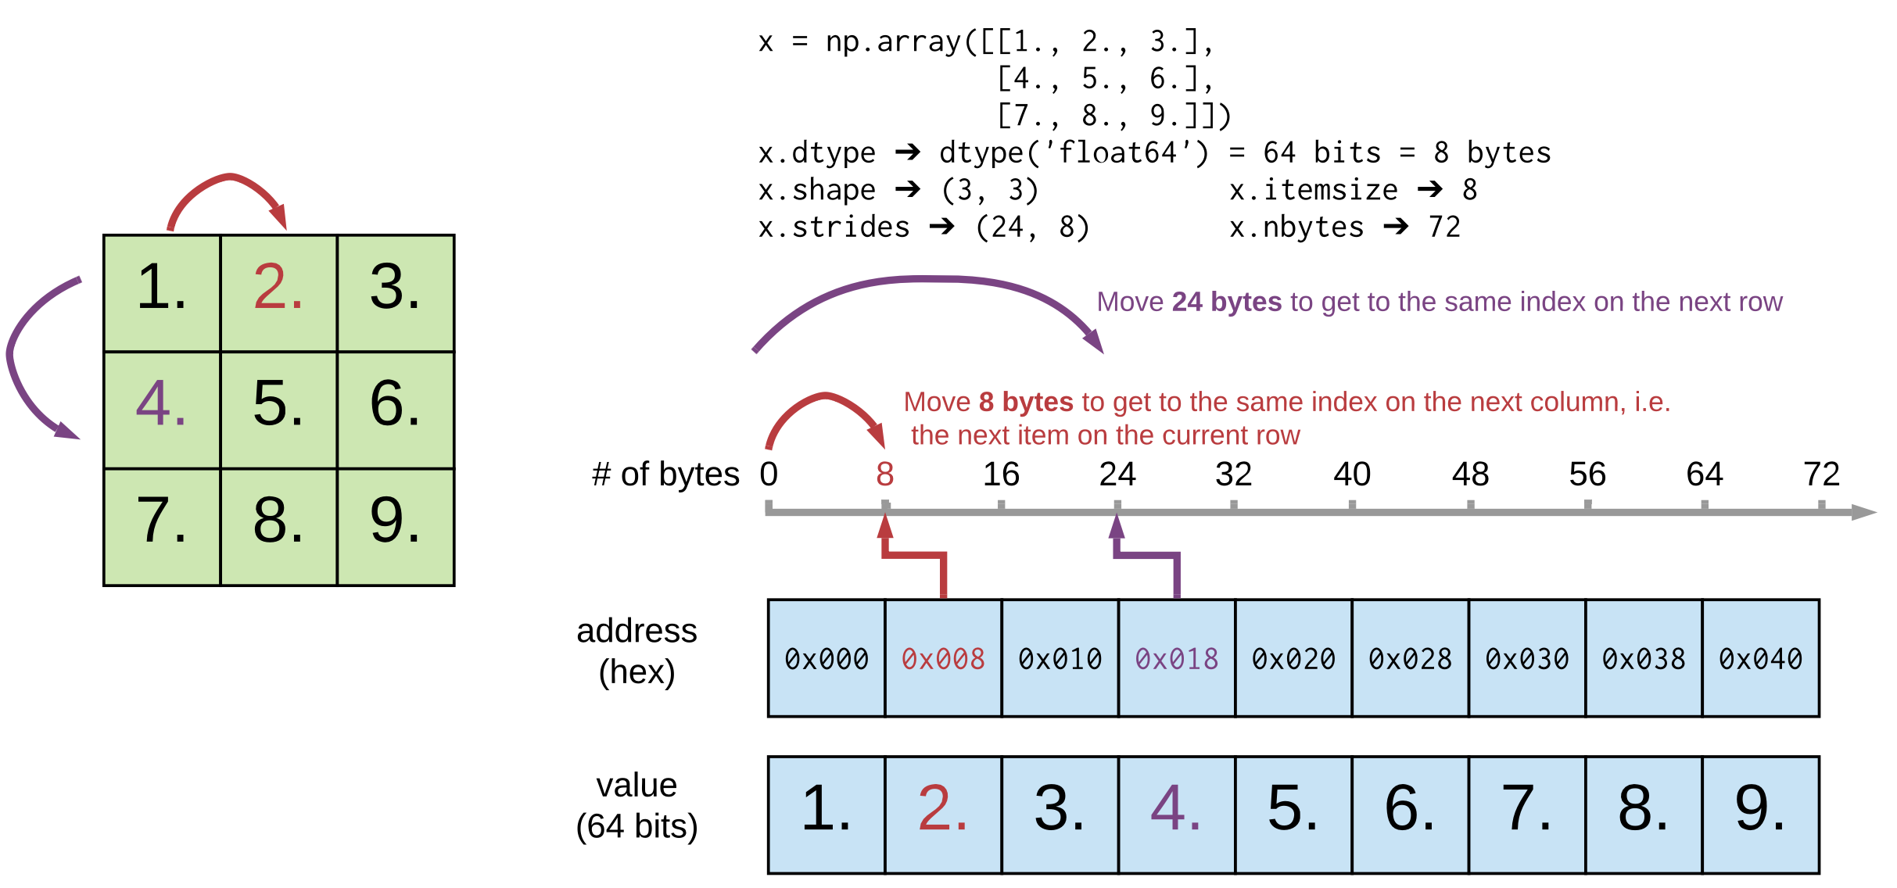
Efficiency of NumPy
Memory:
data occupies the minimum amount of memory required
some operations can be done without touching the memory at all!
Notes:
The standard Python implementation is written in C. This means that every Python object is simply a cleverly-disguised C structure, which contains not only its value, but metadata as well
a C integer is essentially a label for a position in memory whose bytes encode an integer value. A Python integer is a pointer to a position in memory containing all the Python object information, including the bytes that contain the integer value
NumPy handles looping over array elements near-optimally—for example, taking strides into consideration to best utilize the computer’s fast cache memory
NumPy array - single pointer to one contiguous block of data
The Python list, on the other hand, contains a pointer to a block of pointers, each of which in turn points to a full Python object

Slide 5
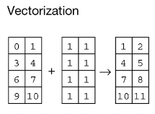
Efficiency of NumPy
Memory:
data occupies the minimum amount of memory required
some operations can be done without touching the memory at all!
Speed:
Many operations can be done very efficiently in C → avoid Python for-loops at all costs!
operating on entire arrays rather than their individual elements
→ “vectorize” the code
Notes:
Speed
Not only efficient storage of data but also
NumPy package comes with a efficient operations on the data done efficiently in C
Option (usually forced, when using NumPy) to operate on entire arrays rather than on their individual elements

Slide 6


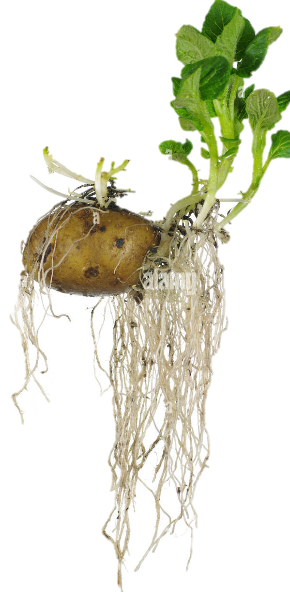

NumPy’s memory efficiency

Slide 7
Memory block
The array data is stored in a contiguous memory block, using native data types
0 | 1 | 2 | 3 | 4 | 5 | 6 | 7 | 8
int64
Notes:
Memory
Since the standard Python implementation is written in C → every Python object is clevery disguised C structure
Contains not only value, but also
Metadata
C integer → a label for a position in memory whose bytes encode an integer value
Python integer → pointer to a position in memory containing all the Python object information, including the bytes that contain the integer value
data occupies the minimum amount of memory required
contiguous data → fast access
fixed datatype → optimized memory usage
some operations can be done without touching the memory at all!

Slide 8
Memory block
0 | 1 | 2 | 3 | 4 | 5 | 6 | 7 | 8
int64
8 bytes
24 bytes
NumPy array metadata
dtype | int64
ndim | 2
shape | (3, 3)
strides | (24, 8)

Slide 9
Memory block
0 | 1 | 2 | 3 | 4 | 5 | 6 | 7 | 8
Metadata tells NumPy how to interpret the memory block
int64
8 bytes
24 bytes
NumPy array metadata
dtype | int64
ndim | 2
shape | (3, 3)
strides | (24, 8)

Slide 10

Memory block
0 | 1 | 2 | 3 | 4 | 5 | 6 | 7 | 8
Metadata tells NumPy how to interpret the memory block
int64
8 bytes
24 bytes
NumPy array metadata
dtype | int64
ndim | 2
shape | (3, 3)
strides | (24, 8)

Slide 11

Memory block
0 | 1 | 2 | 3 | 4 | 5 | 6 | 7 | 8
Metadata tells NumPy how to interpret the memory block
int64
8 bytes
24 bytes
NumPy array metadata
NumPy view
dtype | int64
ndim | 2
shape | (3, 3)
strides | (24, 8)
0 | 1 | 2
3 | 4 | 5
6 | 7 | 8

Slide 12
Memory block
0 | 1 | 2 | 3 | 4 | 5 | 6 | 7 | 8
The same memory block can be interpreted in many ways
NumPy operation
NumPy view
0 | 1 | 2
3 | 4 | 5
6 | 7 | 8
x
x.ravel()
0 | 1 | 2 | 3 | 4 | 5 | 6 | 7 | 8
0 | 3 | 6
1 | 4 | 7
2 | 5 | 8
x.T
0 | 2
6 | 8
x[::2, ::2]
Notes:
The same memory block can be interpreted in many ways → that means that there are operations that cost nothing because they only change the metadata
NumPy view and operations
Operations that require no time at all because noting is changing , only the metadata
Any operation that only needs to change the metadata. NumPy very efficient
Every time it can, it can only change thet metadata
Operations that can only change the metadata → return a view (introduce new concept)

Slide 13
Memory block
0 | 1 | 2 | 3 | 4 | 5 | 6 | 7 | 8
The same memory block can be interpreted in many ways
NumPy operation
NumPy view
0 | 1 | 2
3 | 4 | 5
6 | 7 | 8
x
x.ravel()
0 | 1 | 2 | 3 | 4 | 5 | 6 | 7 | 8
0 | 3 | 6
1 | 4 | 7
2 | 5 | 8
x.T
0 | 2
6 | 8
x[::2, ::2]
Notes:
The same memory block can be interpreted in many ways → that means that there are operations that cost nothing because they only change the metadata
NumPy view and operations
Operations that require no time at all because noting is changing , only the metadata
Any operation that only needs to change the metadata. NumPy very efficient
Every time it can, it can only change thet metadata
Operations that can only change the metadata → return a view (introduce new concept)

Slide 14
Memory block
0 | 1 | 2 | 3 | 4 | 5 | 6 | 7 | 8
The same memory block can be interpreted in many ways
NumPy operation
NumPy array metadata
NumPy view
dtype | int64
ndim | 2
shape | (3, 3)
strides | (24, 8)
0 | 1 | 2
3 | 4 | 5
6 | 7 | 8
x
dtype | int64
ndim | 1
shape | (9,)
strides | (8,)
x.ravel()
0 | 1 | 2 | 3 | 4 | 5 | 6 | 7 | 8
dtype | int64
ndim | 2
shape | (3, 3)
strides | (8, 24)
0 | 3 | 6
1 | 4 | 7
2 | 5 | 8
x.T
dtype | int64
ndim | 2
shape | (2, 2)
strides | (48, 16)
0 | 2
6 | 8
x[::2, ::2]
Notes:
The same memory block can be interpreted in many ways → that means that there are operations that cost nothing because they only change the metadata
NumPy view and operations
Operations that require no time at all because noting is changing , only the metadata
Any operation that only needs to change the metadata. NumPy very efficient
Every time it can, it can only change thet metadata
Operations that can only change the metadata → return a view (introduce new concept)

Slide 15
Memory block
0 | 1 | 2 | 3 | 4 | 5 | 6 | 7 | 8
There are NumPy operations that can be performed just by changing the metadata
NumPy operation
NumPy array metadata
NumPy view
very efficient --> O(1)
dtype | int64
ndim | 2
shape | (3, 3)
strides | (24, 8)
0 | 1 | 2
3 | 4 | 5
6 | 7 | 8
x
dtype | int64
ndim | 1
shape | (9,)
strides | (8,)
x.ravel()
0 | 1 | 2 | 3 | 4 | 5 | 6 | 7 | 8
dtype | int64
ndim | 2
shape | (3, 3)
strides | (8, 24)
0 | 3 | 6
1 | 4 | 7
2 | 5 | 8
x.T
dtype | int64
ndim | 2
shape | (2, 2)
strides | (48, 16)
0 | 2
6 | 8
x[::2, ::2]
Notes:
The same memory block can be interpreted in many ways → that means that there are operations that cost nothing because they only change the metadata
NumPy view and operations
Operations that require no time at all because noting is changing , only the metadata
Any operation that only needs to change the metadata. NumPy very efficient
Every time it can, it can only change thet metadata
Operations that can only change the metadata → return a view (introduce new concept)

Slide 16
Memory block
0 | 1 | 2 | 3 | 4 | 5 | 6 | 7 | 8
NumPy operation
NumPy array metadata
NumPy view
dtype | int64
ndim | 2
shape | (3, 3)
strides | (24, 8)
0 | 1 | 2
3 | 4 | 5
6 | 7 | 8
x
What’s the output?
x[ [0, 1, 2], [1, 0, 1] ]
Notes:
The same memory block can be interpreted in many ways → that means that there are operations that cost nothing because they only change the metadata
NumPy view and operations
Operations that require no time at all because noting is changing , only the metadata
Any operation that only needs to change the metadata. NumPy very efficient
Every time it can, it can only change thet metadata
Operations that can only change the metadata → return a view (introduce new concept)

Slide 17
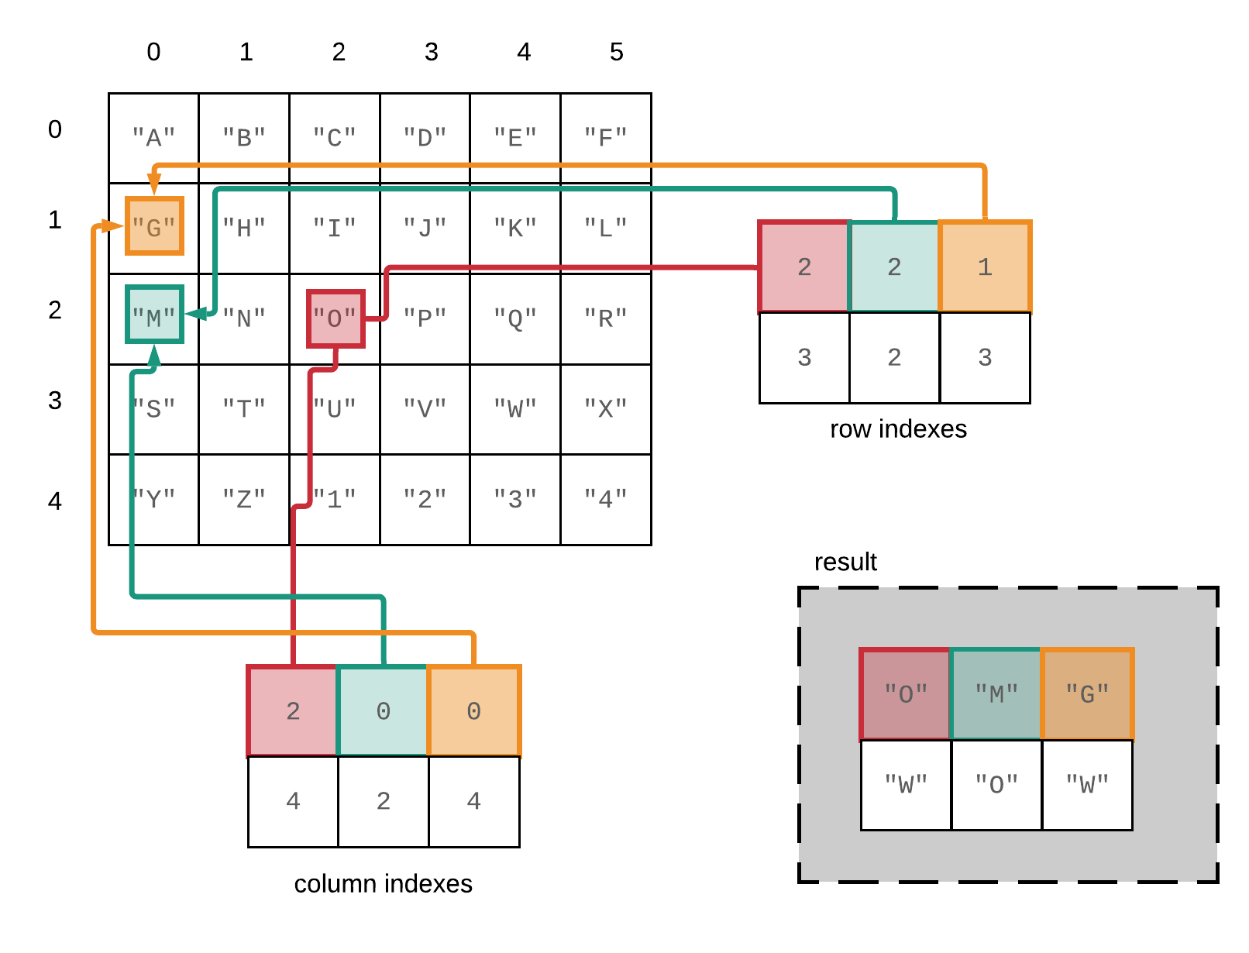
Fancy indexing in NumPy – reference slide
A[[2, 2, 1], [2, 0, 0]]

Slide 18
Memory block
0 | 1 | 2 | 3 | 4 | 5 | 6 | 7 | 8
The same memory block can be interpreted in many ways
NumPy operation
NumPy array metadata
NumPy view
dtype | int64
ndim | 2
shape | (3, 3)
strides | (24, 8)
0 | 1 | 2
3 | 4 | 5
6 | 7 | 8
x
How does the metadata look in this case?
dtype
ndim
shape
strides
x[ [0, 1, 2], [1, 0, 1] ]
1 | 3 | 7
Notes:
The same memory block can be interpreted in many ways → that means that there are operations that cost nothing because they only change the metadata
NumPy view and operations
Operations that require no time at all because noting is changing , only the metadata
Any operation that only needs to change the metadata. NumPy very efficient
Every time it can, it can only change thet metadata
Operations that can only change the metadata → return a view (introduce new concept)

Slide 19
Memory block
0 | 1 | 2 | 3 | 4 | 5 | 6 | 7 | 8
The same memory block can be interpreted in many ways
NumPy operation
NumPy array metadata
NumPy view
dtype | int64
ndim | 2
shape | (3, 3)
strides | (24, 8)
0 | 1 | 2
3 | 4 | 5
6 | 7 | 8
x
In this case new memory needs to be allocated
Another memory block
1 | 3 | 7
dtype | Int 64
ndim | 1
shape | (3,)
strides | (8,)
x[ [0, 1, 2], [1, 0, 1] ]
1 | 3 | 7
Notes:
The same memory block can be interpreted in many ways → that means that there are operations that cost nothing because they only change the metadata
NumPy view and operations
Operations that require no time at all because noting is changing , only the metadata
Any operation that only needs to change the metadata. NumPy very efficient
Every time it can, it can only change thet metadata
Operations that can only change the metadata → return a view (introduce new concept)

Slide 20

Operations that only change the metadata return a “view “ of the original memory block, otherwise a new memory block needs to be allocated, returning a “copy”
Notes:
Two sets of operations
1.Only change metadata
2. New memory block is allocated → return a copy (in NumPy we say)

Slide 21

Operations that only change the metadata return a “view “ of the original memory block, otherwise a new memory block needs to be allocated, returning a “copy”
Live Coding
notebooks/NumPy/NumPy_views_and_copies.ipynb
Notes:
Two sets of operations
1.Only change metadata
2. New memory block is allocated → return a copy (we say)

Slide 22
NumPy views and copies
Live Coding
notebooks/NumPy/NumPy_views_and_copies.ipynb
View
accessing the array without changing the memory block
slicing gives views
in-place operations modify the memory block and all of its views
Copy
when a copy of an array needs to be created, it allocates a separate memory block and associates it with a new metadata
fancy indexing always gives copies
a copy can be forced by method .copy()

Slide 23

NumPy views and copies
View
accessing the array without changing the memory block
slicing gives views
in-place operations modify the memory block and all of its views
Copy
when a copy of an array needs to be created, it allocates a separate memory block and associates it with a new metadata
fancy indexing always gives copies
a copy can be forced by method .copy()
Exercise
exercises/view_or_copy/view_or_copy.ipynb

Slide 24
A special kind of view: broadcasting operations
Memory block
0 | 1 | 2 | 3 | 4 | 5 | 6 | 7 | 8
NumPy array metadata
dtype | int64
ndim | 2
shape | (4, 9)
strides | (0, 8)
The shape says we have 4 rows and 9 columns
A stride of 0 means that for each new row, we don’t move in memory
Notes:
Special case, when one of the strides is 0 → duplicates without occupying more memory
Transition, other operations that can
Braodcasting
Imagine what happens if we have a stride of 0
It allows us to replicate the sae row without allocating extra memory
What happens when it’s a 0?

Slide 25
A special kind of view: broadcasting operations
Memory block
As a result, we obtain a view with duplicated rows, without using extra memory!
0 | 1 | 2 | 3 | 4 | 5 | 6 | 7 | 8
NumPy array metadata
NumPy view
dtype | int64
ndim | 2
shape | (4, 9)
strides | (0, 8)
The shape says we have 4 rows and 9 columns
0 | 1 | 2 | 3 | 4 | 5 | 6 | 7 | 8
0 | 1 | 2 | 3 | 4 | 5 | 6 | 7 | 8
0 | 1 | 2 | 3 | 4 | 5 | 6 | 7 | 8
0 | 1 | 2 | 3 | 4 | 5 | 6 | 7 | 8
A stride of 0 means that for each new row, we don’t move in memory
Notes:
Stride == 0 → then we are not actually moving in memory, same memory, we are looping over the same thing

Slide 26
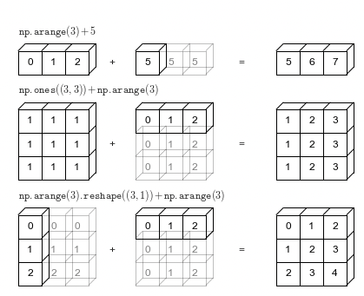
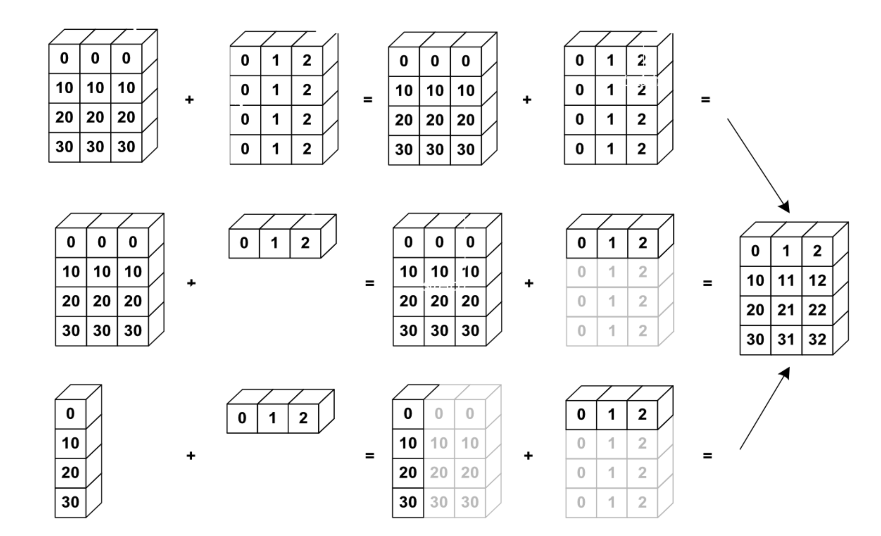
NumPy uses broadcasting to perform operation on arrays of different shape without having to allocate extra memory
Notes:
Again the kaleidoscope metaphor, it’s an aritifical way to replicate something

Slide 27
Broadcasting notebook summary
Dive in Broadcastig
notebooks/NumPy/broadcasting.ipynb
how NumPy treats arrays with different shapes during arithmetic operations
Rules of broadcasting
1: If the two arrays differ in their number of dimensions, the shape of the one with fewer dimensions is padded with ones on its leading (left) side.
2: If the shape of the two arrays does not match in any dimension, the array with shape equal to 1 in that dimension is stretched to match the other shape.
3: If in any dimension the sizes disagree and neither is equal to 1, an error is raised.
Notes:
Show 1,2 examples and the notebook with the rules/ their implementation

Slide 28

NumPy’s speed efficiency
Notes:
We don’t only need to look at the arrays but al
NumPy kaleidoscope on looking at the memory block → efficient operations
But we can also do stuff and not only look at the

Slide 29
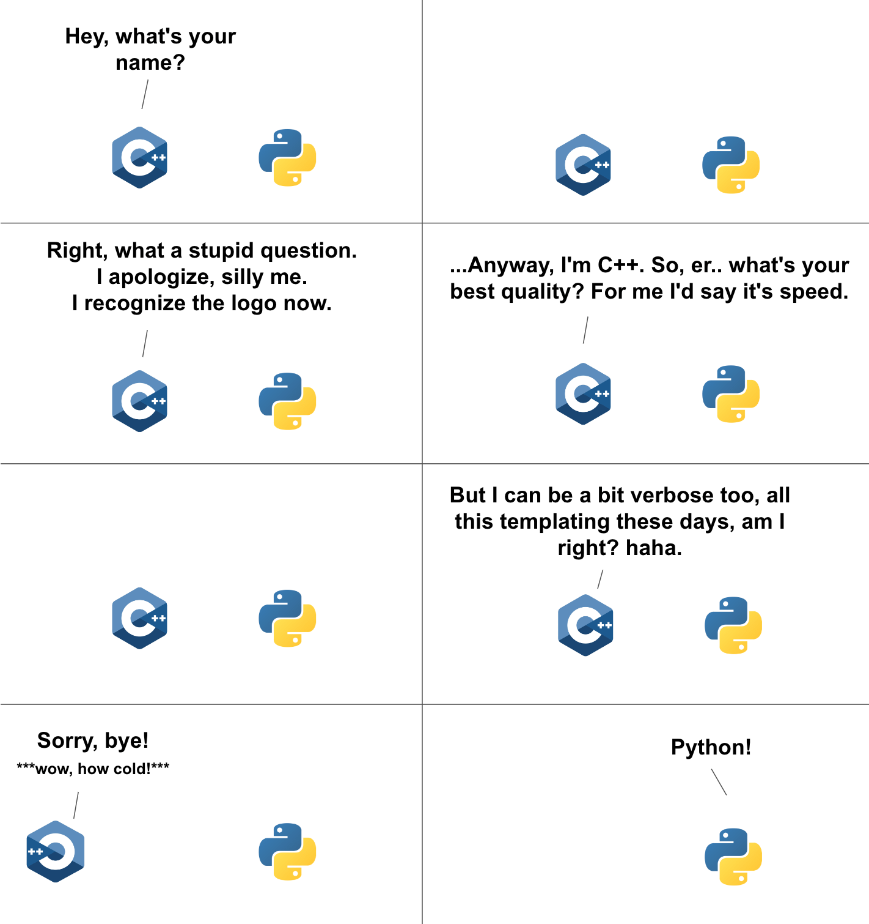
For-loops in Python vs in C
Data is of a C numerical type → regular layout in memory
A C loop can jump from one memory location to the next by moving by “strides” bytes and accumulating the result
To get that performance, one needs to vectorize! it’s important to avoid for-loops at all costs (with NumPy in Python)
Notes:
a = x[::2, 3]
a.sum()
start_memory_pos = a.data
a.dtype sum = 0
for i in a.shape[0]:
for j in a.shape[1]:
memory_pos = start_memory_pos + a.strides[0] * i + a.strides[1] * j
sum += cast_to(memory_pos, a.dtype)

Slide 30


Vectorization
operations performed on entire arrays at once
Faster computation
no looping through each element individually
Notes:
With many cases you can get away from using for loops by using those basic operatons or aggregation functions
Sometimes you’d need to be clever. E.g. use clever broadcaintg with meshgrid

Slide 31
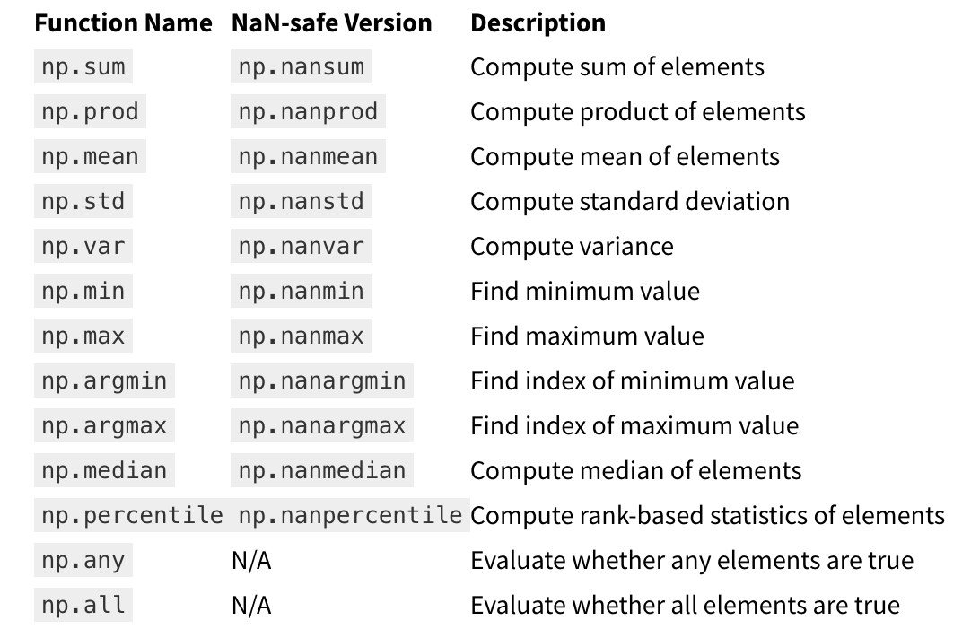
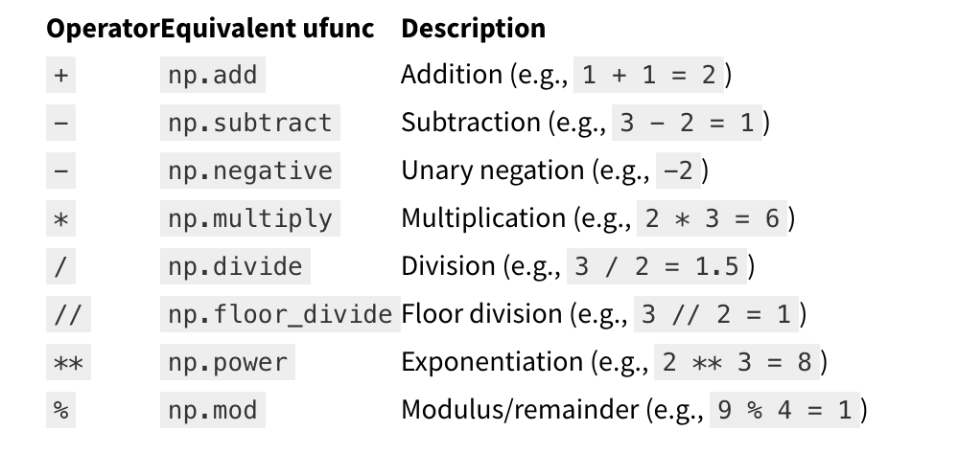
Vectorization
operations performed on entire arrays at once
Single function call
Faster computation
no looping through each element individually
Aggregation functions
Basic operators
Notes:
With many cases you can get away from using for loops by using those basic operatons or aggregation functions
Sometimes you’d need to be clever. E.g. use clever broadcaintg with meshgrid

Slide 32
For-loops in Python vs in C
Data is of a C numerical type → regular layout in memory
A C loop can jump from one memory location to the next by moving by “strides” bytes and accumulating the result
To get that performance, one needs to vectorize! it’s important to avoid for-loops at all costs (with NumPy in Python)
How is efficiency of Python vs C in the Big-O sense?
Notes:
From memory block too
Режжелагин тхе отхер блаоцк боь
Inefficient algorithms stay inefficient
a = x[::2, 3]
a.sum()
start_memory_pos = a.data
a.dtype sum = 0
for i in a.shape[0]:
for j in a.shape[1]:
memory_pos = start_memory_pos + a.strides[0] * i + a.strides[1] * j
sum += cast_to(memory_pos, a.dtype)

Slide 33
Exercise: vectorize the code
Exercise
exercises/NumPy_vectorize/ NumPy_vectorize.ipynb

Slide 34
HERE INSERT Tabular Data SLIDES

